Slide 1
Flutter Stock Management App
CPAD Assignment 1
Bhuvaneshwar K Kanade
2023mt13031@wilp.bits-pilani.ac.in

Slide 2
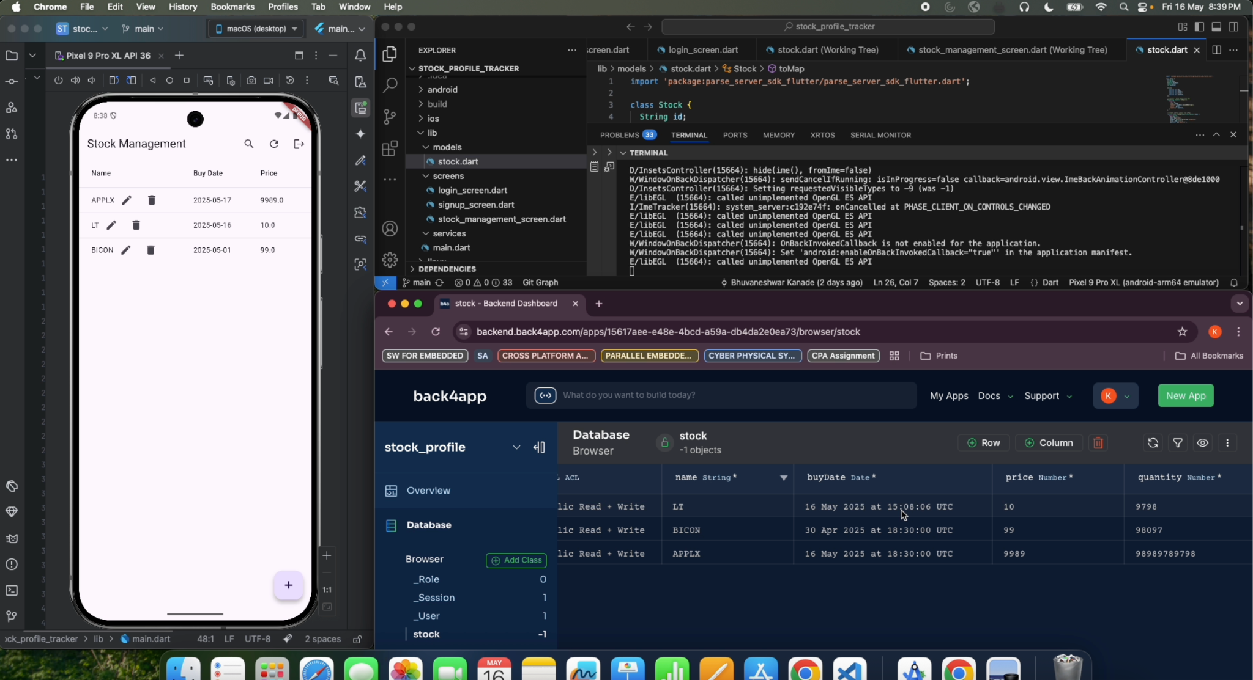
Stock Profile Tracker:
Users can sign up, log in, and manage stock entries.
Supports CRUD operations: add, view, edit, delete stocks.
Tracks stock name, buy date, price, quantity.
Data stored and synced via Back4App (Parse Server).
Access portfolio securely from phone device.
App Structure :
models : stock.dart, defines the Stock object and its CRUD operations with Back4App.
Screens :
login_screen.dart: user login and password reset.
signup_screen.dart: user registration.
stock_management_screen.dart: Main screen for viewing, adding, editing, deleting, and querying stocks.
Main.dart : Entry point of the app. Initializes Back4App and sets up the root widget.
User Authentication :
Sign Up: Register with username, email, password using ParseUser.signUp().
Login: Log in with credentials via ParseUser.login(), then navigate to stock screen.
Session: Auto-managed by SDK; check session on start, logout via ParseUser.logout().
Reset: Request reset email using ParseUser.requestPasswordReset(email).
Back4App Integration:
Uses Back4App with Parse Server SDK for Flutter as backend.
Initialization: In main.dart using Parse().initialize() with appId, clientKey, serverURL.
Data Storage: Uses ParseObject API to perform CRUD on stock data.
User Management: Uses ParseUser API; sessions managed automatically.
Git Link
Video Link

